Slide 1

Styling Made Awesome
Presenter:
Daniel McCarthy
Date:
10/16/2019

Slide 2

Initial release: 1996
Current version: CSS 3 (2017)
Doesn’t support logic
Pseudo selectors such as :nth-child(n)

Slide 3
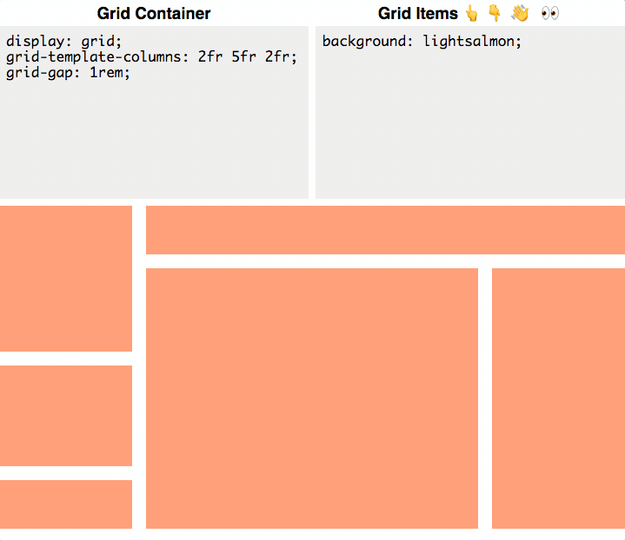
Grid

Slide 4


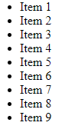
Browser(s):
CSS:

Slide 5
Browser(s):
CSS: | .grid-container { display: grid; grid-template-columns: repeat(3, 1fr); }

Slide 6
Browser(s):
CSS: | .grid-container { display: grid; grid-template-columns: repeat(3, 1fr); }

Slide 7
Browser(s):
CSS: | .grid-container { /* IE grid support */ display: -ms-grid; /* cannot utilize the repeat function */ -ms-grid-columns: 1fr 1fr 1fr; display: grid; grid-template-columns: repeat(3, 1fr); }

Slide 8
Browser(s):
CSS: | .grid-container > li:nth-child(3n + 1) { -ms-grid-column: 1; } .grid-container > li:nth-child(3n + 2) { -ms-grid-column: 2; } .grid-container > li:nth-child(3n) { -ms-grid-column: 3; }

Slide 9
Browser(s):
CSS: | .grid-container > li:nth-child(n - 4) { -ms-grid-row: 1; } .grid-container > li:nth-child(n + 4) { -ms-grid-row: 2; } .grid-container > li:nth-child(n + 7) { -ms-grid-row: 3; }

Slide 10
Browser(s):
CSS: | .grid-container { /* IE grid support */ display: -ms-grid; /* cannot utilize the repeat function */ -ms-grid-columns: 1fr 1fr 1fr; display: grid; grid-template-columns: repeat(3, 1fr); } | .grid-container > li:nth-child(3n + 1) { -ms-grid-column: 1; } .grid-container > li:nth-child(3n + 2) { -ms-grid-column: 2; } .grid-container > li:nth-child(3n) { -ms-grid-column: 3; } | .grid-container > li:nth-child(n - 4) { -ms-grid-row: 1; } .grid-container > li:nth-child(n + 4) { -ms-grid-row: 2; } .grid-container > li:nth-child(n + 7) { -ms-grid-row: 3; }

Slide 11
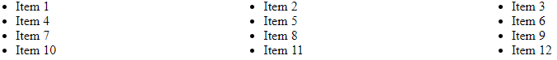
Browser(s):
Browser(s):

Slide 12
“Syntactically Awesome Style Sheets”
Mitigates complex, lengthy and unmanageable CSS
An extension to CSS
Gets compiled back into CSS
Indented syntax
Notes:
The year is 2006 and already people are getting lazy about their CSS, much like this script.
While everyone appreciates CSS, they wish it had a cooler anagram.
This is what gave birth to SASS, or "syntactically awesome style sheets".
SASS was developed to address a growing problem, pun intended.
Stylesheets where (and still are) becoming more and more complex and lengthy, making them harder to maintain.
SASS implemented ways to mitigate this: mixins, nested selectors, variables, inheritance and functions.
The language can be seen as an extension to CSS.
The features I just meantioned belong to SASS, but they must be broken down by a preprocessor back into good ole CSS.
Take note of this as SASS is not meant to somehow inject dynamic styling into your webapp, it just allows you to write and manage your CSS easier.
SASS was nearly the golden standard, nearly.
Old habits die hard and SASS tried to teach too new of a trick some old dogs.
The SASS files utilized a syntax call "the indented syntax", similar to Haml (same developer invented both!).

Slide 13
selector1 style: value selector2 style: value | selector1 { style: value; } selector2 { style: value; }
Notes:
Essentially, each line of SASS looked like CSS minus semicolons and brackets.
This confused people and additionally had a major hitch: What if people wanted to port over their old CSS?
In that case, they would have to translate the CSS to SASS.

Slide 14
SCSS (no logo so they get comic sans)
“Sassy CSS”
Syntax of
All the features of

Slide 15
SCSS
selector1 {
style: value;
}
selector2 {
style: value;
}

Slide 16
Mixins

Slide 17
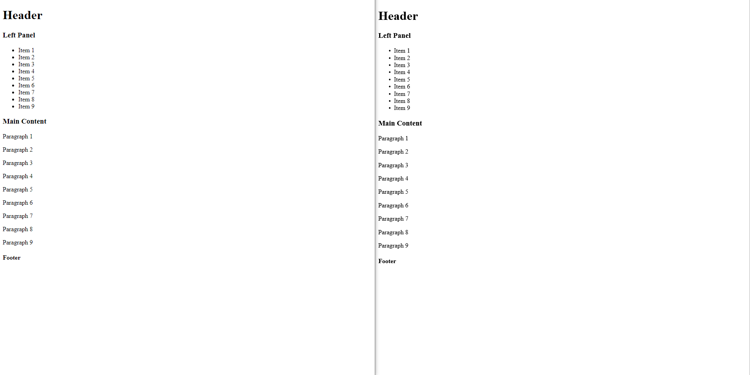

Slide 18
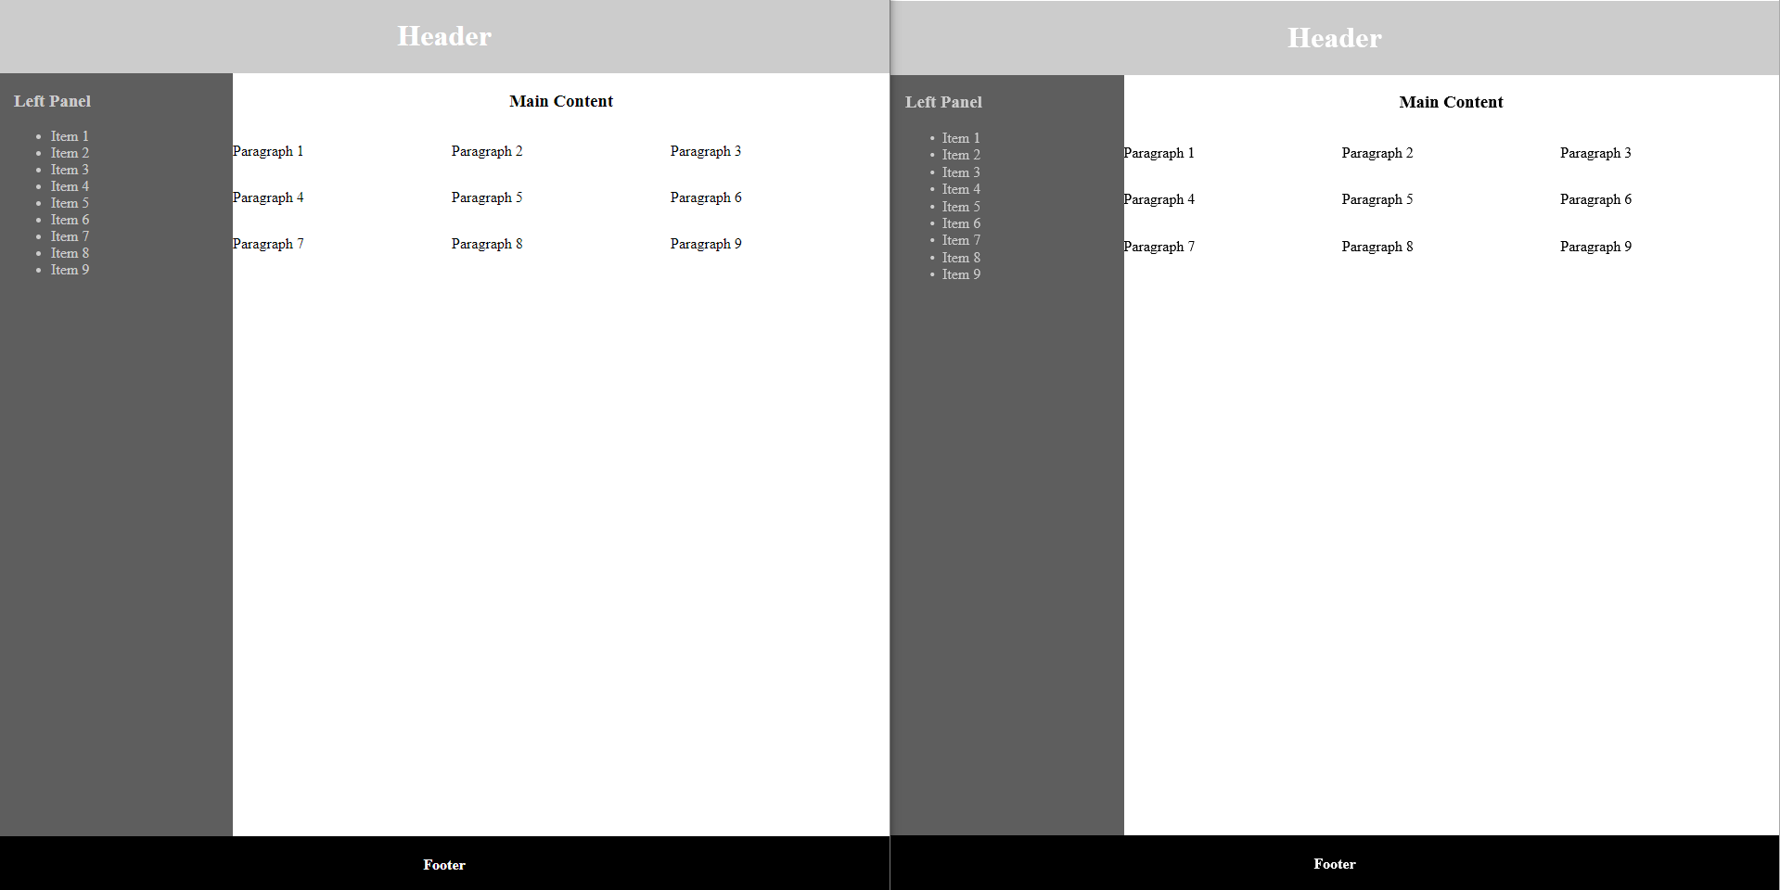

Slide 19
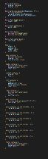
SCSS

Slide 20
SCSS
@mixin text-center-mixin { text-align: center; } @mixin grid-mixin { display: -ms-grid; display: grid; } @mixin grid-cols-mixin($colDimensions: 1fr) { @include grid-mixin; -ms-grid-columns: $colDimensions; grid-template-columns: $colDimensions; } | @mixin full-height-mixin { height: 100%; } @mixin full-width-mixin { width: 100%; } @mixin full-mixin { @include full-height-mixin; @include full-width-mixin; }

Slide 21
SCSS
@mixin full-height-mixin { height: 100%; } @mixin full-width-mixin { width: 100%; } @mixin full-mixin { @include full-height-mixin; @include full-width-mixin; } .body-container { @include full-mixin; display: flex; flex-direction: column; } | .body-container { height: 100%; width: 100%; display: flex; flex-direction: column; }

Slide 22
SCSS
@mixin grid-mixin { display: -ms-grid; display: grid; } @mixin grid-cols-mixin($colDimensions: 1fr) { @include grid-mixin; -ms-grid-columns: $colDimensions; grid-template-columns: $colDimensions; } .main-container { @include grid-cols-mixin(1fr 1fr 1fr); text-align: left; } | .main-container { display: -ms-grid; display: grid; -ms-grid-columns: 1fr 1fr 1fr; grid-template-columns: 1fr 1fr 1fr; text-align: left; }

Slide 23
Mixins
Declared at the top of your SCSS
Used to make CSS reusable
Only create a mixin when CSS needs to be reused
Notes:
Here's how you should consider mixins:
Mixins should be used to make you CSS more readable, to remove complexity and to remove redundant styles.
In the SCSS I created, you'll note that every mixin I made is either being used at least twice or will likely be used in the future.
Also note that even though some styles are used twice or more, they don't have a mixin created for them.
In these cases, the mixin would just take longer to declare and use than the raw CSS style itself, you would gain nothing.
Only create a mixin when there is a current or near future need to include the mixin in multiple classes.
The hope is that in the long run you will be declaring far fewer CSS styles and using more predefined mixins to clean up your SCSS files.

Slide 24
Nested Selectors

Slide 25
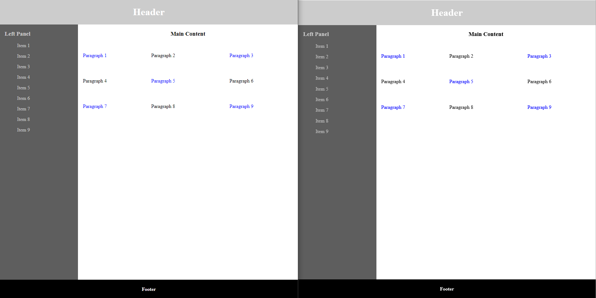

Slide 26
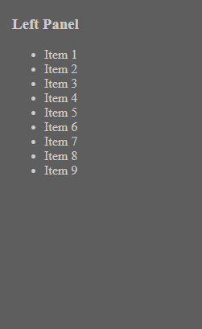
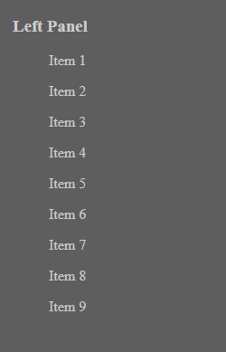
SCSS
.left-container {
flex: 1;
padding-left: 1rem;
background-color: #5e5e5e;
color: #ccc;
> ul {
list-style-type: none;
> li {
margin-bottom: 1rem;
}
}
}
Before | After
Notes:
You'll want to mostly use specific class selectors as otherwise you might end up affecting child elements downstream if you're not careful.

Slide 27
SCSS
.left-container { flex: 1; padding-left: 1rem; background-color: #5e5e5e; color: #ccc; > ul { list-style-type: none; > li { margin-bottom: 1rem; } } } | .left-container { flex: 1; padding-left: 1rem; background-color: #5e5e5e; color: #ccc; } .left-container > ul { list-style-type: none; } .left-container > ul > li { margin-bottom: 1rem; }

Slide 29
SCSS
.main-container { @include grid-cols-mixin(1fr 1fr 1fr); text-align: left; > p { padding: 1rem; } > p:nth-child(odd) { color: blue; } > p:nth-child(3n + 2) { padding: 1rem 0; } > p:nth-child(3n + 1) { -ms-grid-column: 1; } | > p:nth-child(3n + 2) { -ms-grid-column: 2; } > p:nth-child(3n) { -ms-grid-column: 3; } > p:nth-child(n - 4) { -ms-grid-row: 1; } > p:nth-child(n + 4) { -ms-grid-row: 2; } > p:nth-child(n + 7) { -ms-grid-row: 3; } }

Slide 30
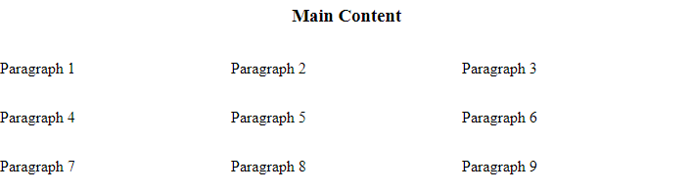
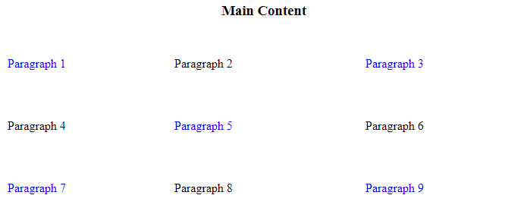
SCSS
Before
> p {
padding: 1rem;
}
> p:nth-child(odd) {
color: blue;
}
> p:nth-child(3n + 2) {
padding: 1rem 0;
}
After

Slide 31
Nested Selectors
Use the most specific selector(s) possible
Do not nest selectors more than 3 layers deep
Make sure nested selectors are the best solution
Notes:
Nested selectors have a caveat, however.
You must not used nested selectors past three layers deep.
Doing so tightly couples your nested styles to your HTML and makes overriding styles later on much more difficult.
We encounter this issue quite often when trying to modify PrimeFaces SCSS and it unfortunately makes SCSS rather hard to maintain.
Nested selectors are also not reusabled, creating redundant code.
Just be aware of what you're trying to accomplish and that nested selectors are the best solution for solving the problem.

Slide 32
Variables

Slide 33
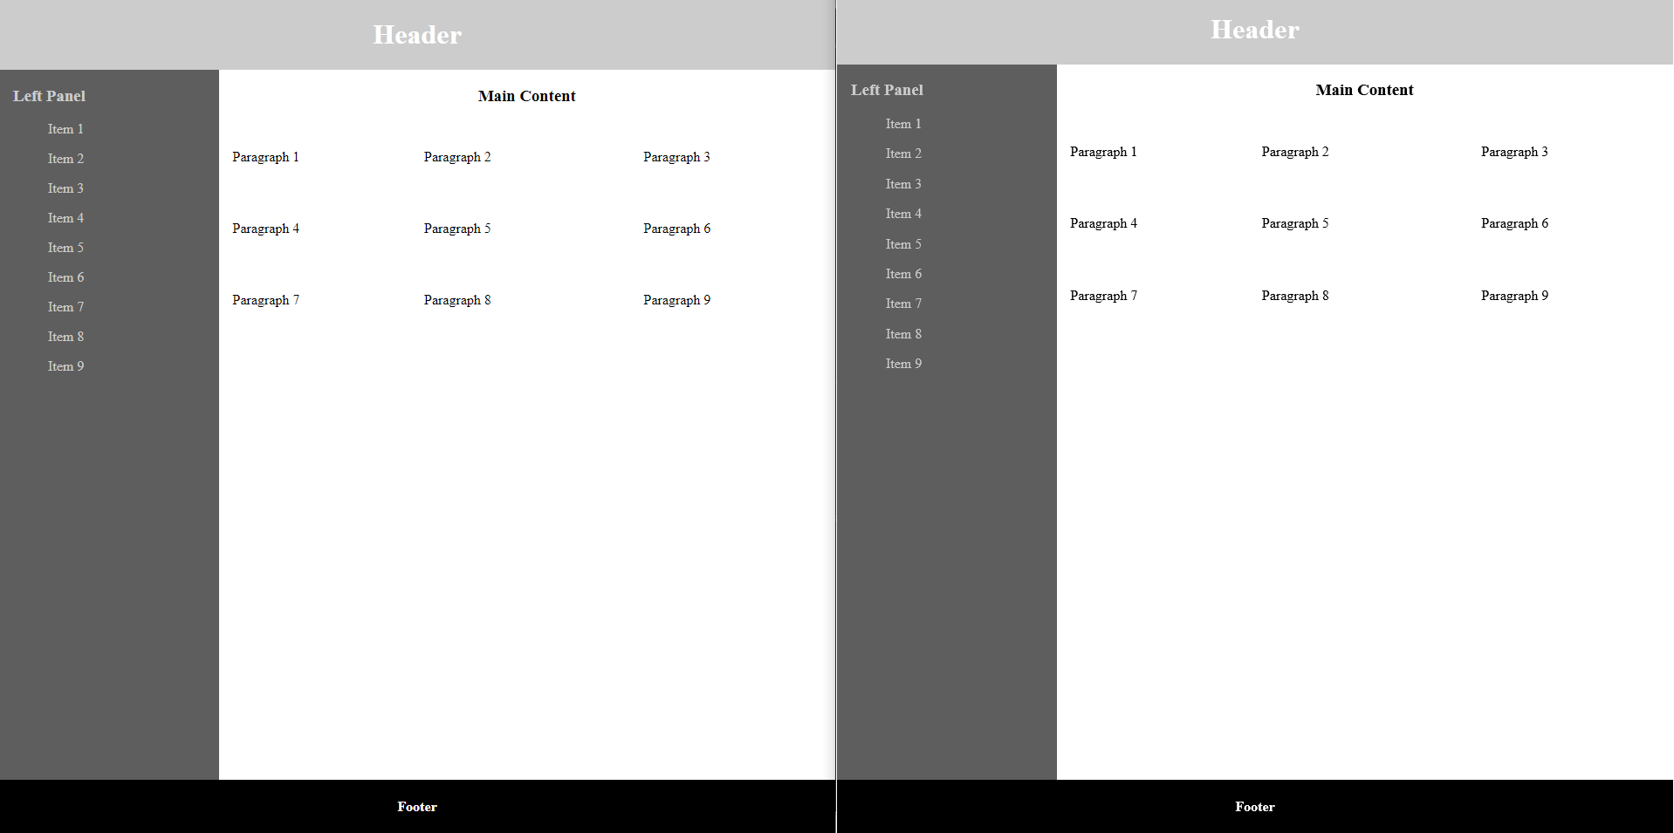

Slide 34
SCSS
$white: #fff; $black: #000; $light-grey: #ccc; $dark-grey: #5e5e5e; $primary-font-color: $white; $secondary-font-color: $light-grey; $primary-background-color: $light-grey; $secondary-background-color: $dark-grey; $tertiary-background-color: $black; | $margin-size: 1rem; $padding-size: 1rem;

Slide 35
SCSS
@import './variables.scss’; | @mixin white-text-mixin { color: $primary-font-color; } | .left-container { flex: 1; padding-left: $padding-size; background-color: $secondary-background-color; color: $secondary-font-color; ul { list-style-type: none; li { margin-bottom: $margin-size; } } }

Slide 36
SCSS
.left-container { flex: 1; padding-left: $padding-size; background-color: $secondary-background-color; color: $secondary-font-color; ul { list-style-type: none; li { margin-bottom: $margin-size; } } } | .left-container { flex: 1; padding-left: 1rem; background-color: #5e5e5e; color: #ccc; } .left-container > ul { list-style-type: none; } .left-container > ul > li { margin-bottom: 1rem; }
$light-grey: #ccc; $dark-grey: #5e5e5e; $secondary-font-color: $light-grey; $secondary-background-color: $dark-grey; | $margin-size: 1rem; $padding-size: 1rem;

Slide 37
SCSS
$primary-font-color: red;
$secondary-font-color: orange;
$primary-background-color: yellow;
$secondary-background-color: green;
$tertiary-background-color: blue;

Slide 38
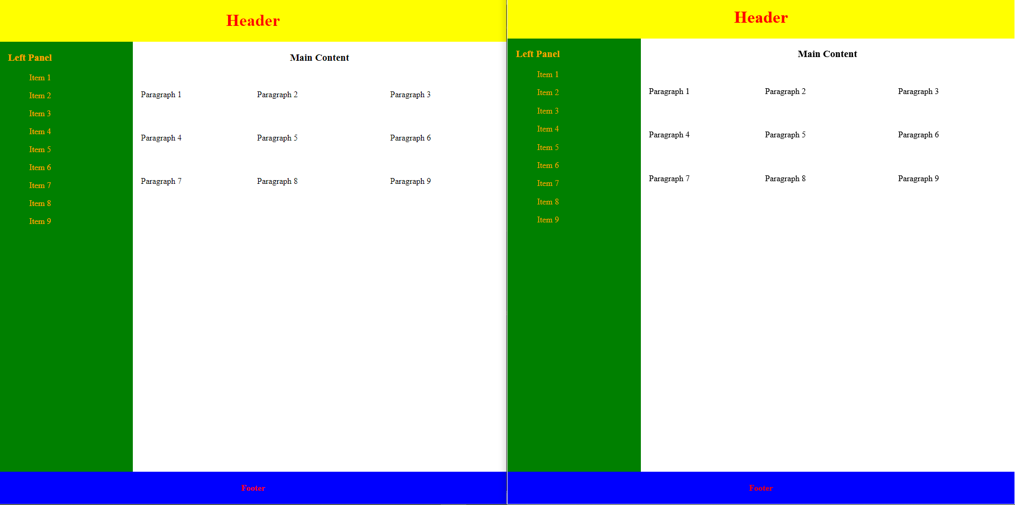

Slide 39
Variables
Declared in separate, specific SCSS files
Can quickly change the look and feel of your app
Makes maintenance far easier

Slide 40
Inheritance

Slide 41
Inheritance
Poorly implemented and documented
Can tightly or weakly couple styles to elements
Commonly misused
Inferior to mixins
Notes:
It's been too calm so here's some opionated controversy regarding SCSS:
Inheritance in SCSS was a good idea but ultimately poorly implemented.
There is a directive in SCSS called @extend which allows you to extend classes from within other classes.
You might think this is similar to using mixins but the generated CSS looks very different.
It's unintuitive and potentially dangerous as it can either tightly couple your SCSS to your HTML or it can create very weak selectors.
These are rather different issues but introduced by the same directive if used improperly, which is common.
Additionally, that fact that mixins exist and handle redundant styles properly invalidates most uses of the @extend directive.
Believing that ignorance is bliss, I will not be showing an example of this and hope that you'll trust me when I say not to use the @extend directive for the reasons I've already mentioned.

Slide 42
Functions

Slide 43
1
1
2
3
2
4
5
6
3
7
8
9
…
33
97
98
99
34
100

Slide 44
.grid-container > li:nth-child(3n + 1) { -ms-grid-column: 1; } .grid-container > li:nth-child(3n + 2) { -ms-grid-column: 2; } .grid-container > li:nth-child(3n) { -ms-grid-column: 3; } | .grid-container > li:nth-child(n - 4) { -ms-grid-row: 1; } .grid-container > li:nth-child(n + 4) { -ms-grid-row: 2; } .grid-container > li:nth-child(n + 7) { -ms-grid-row: 3; } … .grid-container > li:nth-child(n + 97) { -ms-grid-row: 33; } .grid-container > li:nth-child(n + 100) { -ms-grid-row: 34; }

Slide 45
.grid-container > li:nth-child(4n + 1) { -ms-grid-column: 1; } .grid-container > li:nth-child(4n + 2) { -ms-grid-column: 2; } .grid-container > li:nth-child(4n + 3) { -ms-grid-column: 3; } .grid-container > li:nth-child(4n) { -ms-grid-column: 4; } | .grid-container > li:nth-child(n - 5) { -ms-grid-row: 1; } .grid-container > li:nth-child(n + 5) { -ms-grid-row: 2; } .grid-container > li:nth-child(n + 9) { -ms-grid-row: 3; } … .grid-container > li:nth-child(n + 93) { -ms-grid-row: 24; } .grid-container > li:nth-child(n + 97) { -ms-grid-row: 25; }

Slide 46
SCSS
@function pow($base, $exponent) { $result: 1; @for $_ from 1 through $exponent { $result: $result * $base; } @return $result; } .sidebar { float: left; margin-left: pow(4, 3) * 1px; } | .sidebar { float: left; margin-left: 64px; }

Slide 47
SCSS
@function invert($color, $amount: 100%) { $inverse: change-color($color, $hue: hue($color) + 180); @return mix($inverse, $color, $amount); } $primary-color: #036; .header { background-color: invert($primary-color, 80%); } | .header { background-color: #523314; }

Slide 48
SCSS
Equality | Relational | Numeric | String | Boolean
== | > | + | "Helvetica" + " Neue"; // "Helvetica Neue" | true
!= | >= | - | sans- + serif; // sans-serif | false
 | < | * | {10px + 5px} / 30px; // 15px/30px
 | <= | / | sans - serif; // sans-serif
 |  | %

Slide 49
SCSS
@mixin IE-grid-cols-mixin($cols: 3) {
@debug "creating col class: #{$cols} for grid-#{$cols}";
> *:nth-child(#{$cols}n) {
-ms-grid-column: $cols;
}
@for $i from 1 to $cols {
@debug "creating col class: #{$i} for grid-#{$cols}";
> *:nth-child(#{$cols}n + #{$i}) {
-ms-grid-column: $i;
}
}
}
styles.scss:15 Debug: creating col class: 1 for grid-3
styles.scss:15 Debug: creating col class: 2 for grid-3
styles.scss:9 Debug: creating col class: 3 for grid-3
.grid-3-col > *:nth-child(3n) {
-ms-grid-column: 3;
}
.grid-3-col > *:nth-child(3n+1) {
-ms-grid-column: 1;
}
.grid-3-col > *:nth-child(3n+2) {
-ms-grid-column: 2;
}

Slide 50
SCSS
@mixin IE-grid-rows-mixin($cols: 3, $rows: 3) {
// any item less than the number of cols
@debug "creating row class: 1 for grid-#{$cols}";
> *:nth-child(n - #{$cols + 1}) {
-ms-grid-row: 1;
}
@for $i from 1 to $rows {
@debug "creating row class: #{($i + 1)} for grid-#{$cols}";
> *:nth-child(n + #{($cols + 1) + ($cols * ($i - 1))}) {
-ms-grid-row: $i + 1;
}
}
}
styles.scss:30 Debug: creating row class: 2 for grid-3
styles.scss:30 Debug: creating row class: 3 for grid-3
styles.scss:24 Debug: creating row class: 1 for grid-3
.grid-3-col > *:nth-child(n-4) {
-ms-grid-row: 1;
}
.grid-container > li:nth-child(n + 4) { -ms-grid-row: 2; } .grid-container > li:nth-child(n + 7) { -ms-grid-row: 3; }

Slide 51
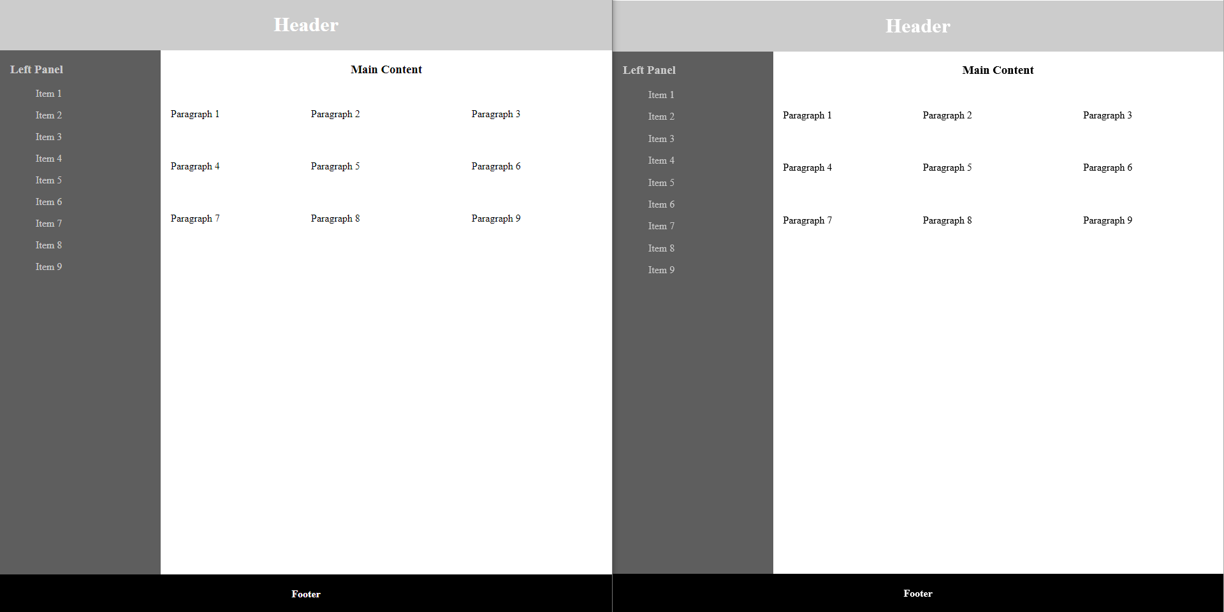

Slide 52
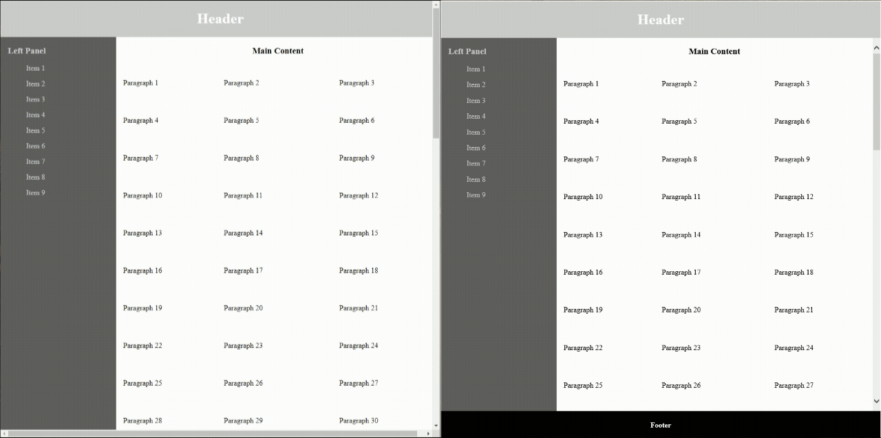
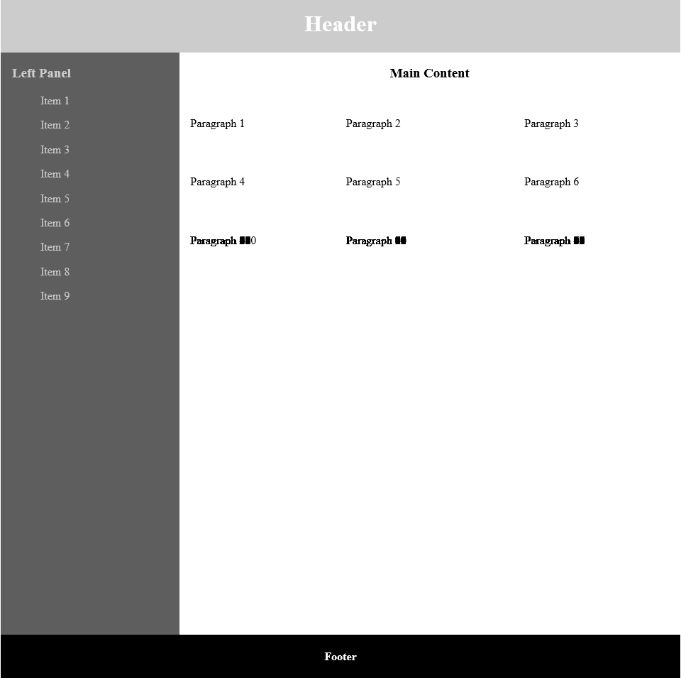

Slide 53
SCSS
@mixin grid-mixin { display: -ms-grid; display: grid; } @mixin grid-cols-mixin($colDimensions: 1fr, $cols: 3, $rows: 3) { @include grid-mixin; -ms-grid-columns: $colDimensions; grid-template-columns: $colDimensions; @include IE-grid-cols-mixin($cols); @include IE-grid-rows-mixin($cols, $rows); } .grid-3-col { @include grid-cols-mixin(1fr 1fr 1fr, 3, 34); }
.grid-3-col {
display: -ms-grid;
display: grid;
-ms-grid-columns: 1fr 1fr 1fr;
grid-template-columns: 1fr 1fr 1fr;
}
.grid-3-col > *:nth-child(n-4) {
-ms-grid-row: 1;
}
.grid-container > li:nth-child(n + 4) {
-ms-grid-row: 2;
}
.grid-container > li:nth-child(n + 7) {
-ms-grid-row: 3;
}
…
.grid-container > li:nth-child(n + 97) {
-ms-grid-row: 33;
}
.grid-container > li:nth-child(n + 100) {
-ms-grid-row: 34;
}
.grid-3-col > *:nth-child(3n) {
-ms-grid-column: 3;
}
.grid-3-col > *:nth-child(3n+1) {
-ms-grid-column: 1;
}
.grid-3-col > *:nth-child(3n+2) {
-ms-grid-column: 2;
}

Slide 55
1
1
2
3
4
2
5
6
7
8
3
9
10
11
11
…
24
93
94
95
96
25
97
98
99
100

Slide 56
SCSS
.grid-4-col {
@include grid-cols-mixin(1fr 1fr 1fr 1fr, 4, 25);
}

Slide 57
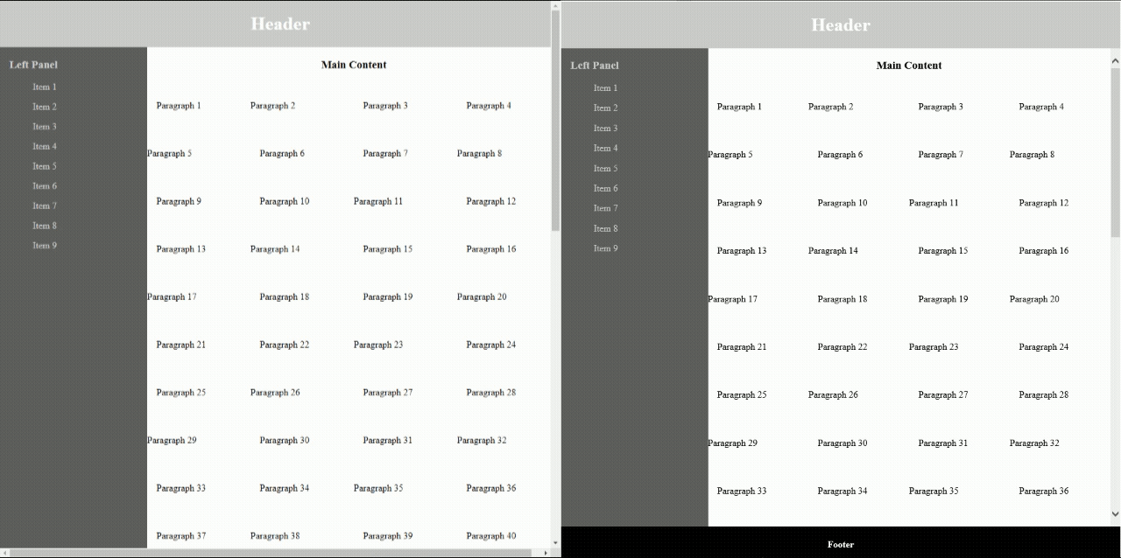

Slide 58
SCSS
&
Pros
Facilitates the creation of good styling
Implements easy workarounds
Makes maintenance a breeze
Cons
Not a silver bullet
Can be misused
The structure is user dependent
Notes:
So here's the gist of SCSS/SASS:
It should not be considered to be a silver bullet for stylesheets, but it certainly does make the creation of stylesheets far easier.
On top of that, rapid style changes can be made if proper structure is maintained and maintainance should be a breeze.
Issues that might have once plagued developers can now be easily sidestepped using it's core features.
Take your time, understand what it is that you're trying to do and SCSS will enable it to happen, good luck!

Slide 59
Questions?

Slide 60
Thank you!

